Slide 1



NETFLIX STOCK PRICE PREDICTION
TEAM MEMBERS: 狄苏菲, 伯汀娜
TIME: 2024/09/30

Slide 2

Tasks:
Project content
Dataset
Correlation analysis
Modeling and prediction
Expected outcome
Our team
Our Project
Infographic
Our Team
Contact Us

Slide 3
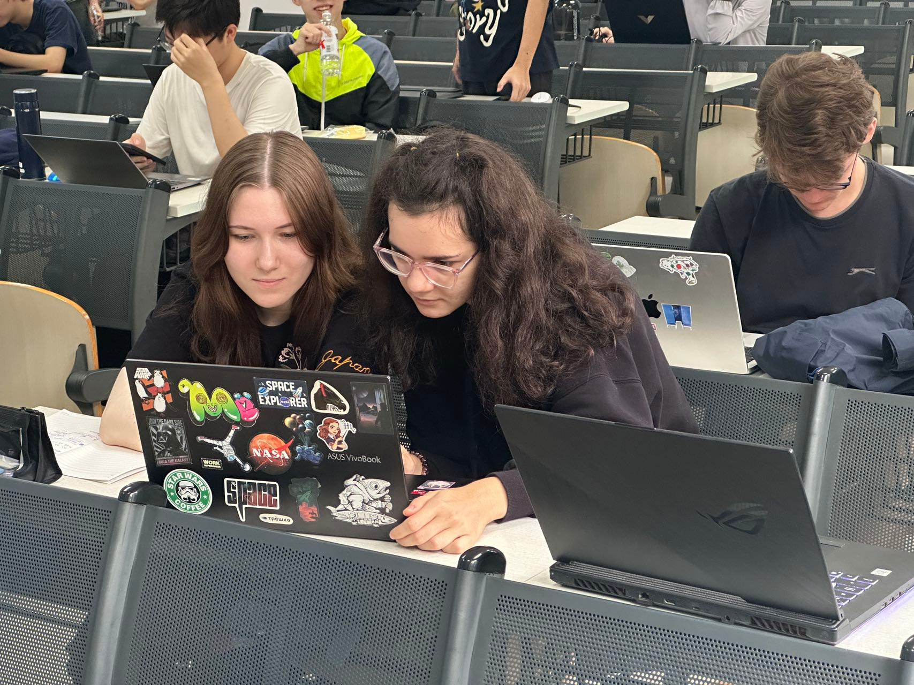
Main Content
We are predicting Netflix stock prices, so potential stock holders will be more confident in their choice.
We will try to predict the prices based on the previous ones. We are going to establish a model for our goal.
CONTINUE

Slide 4
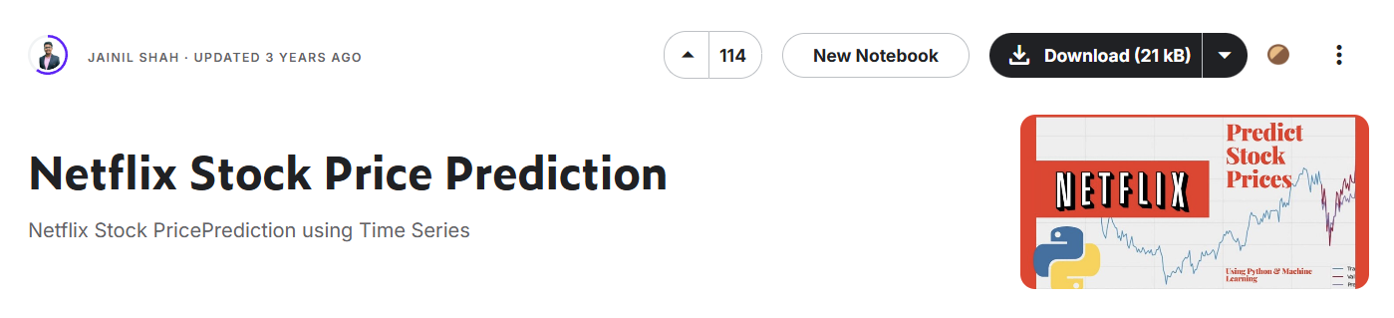
Dataset
The data is derived from the dataset of Netflix Stock Price Prediction by Kaggle.
The Dataset contains data for 5 years i.e. from 5th Feb 2018 to 5th Feb 2022.
CONTINUE

Slide 5

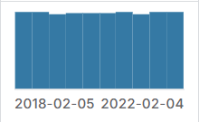
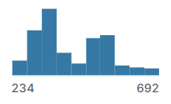
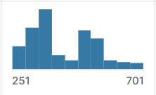
Meaning of data
01.
02.
03.
Date
Open
High
Everyday price
Price from the first transaction of a trading day
Today's High

Slide 6
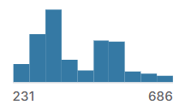
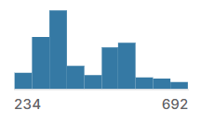
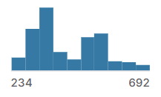
Meaning of data
04.
05.
06.
Low
Close
Adj
Today's Low
Close price adjusted for splits
Adjusted close price

Slide 7
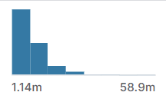
Meaning of data
07.
Volume
Volume of stocks

Slide 8


Data preprocessing
We will find the rows in the dataset that contain missing, wrong or unusable values.
Then we will decide whether to keep the fields and fill in the missing values or simply delete the fields.
CONTINUE

Slide 9
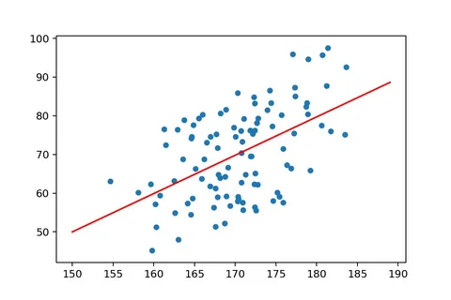
Correlation analysis
Correlation graph example
Based on the columns in the database we need to find the correlation between different previous factors and we will try to define the new price.
We will do it using Python Numpy, Pandas and Matplotlib functions.
CONTINUE

Slide 10
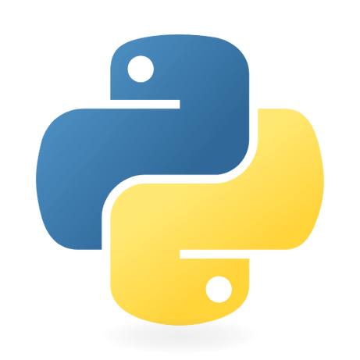
Modeling and Prediction
To model and predict Netflix stock prices, various machine learning techniques can be employed. Key steps include:
Data collection using libraries to fetch historical stock data;
Analyzing factors influencing stock prices, such as market trends;
Implementing algorithms and evaluating performance using metrics.
CONTINUE

Slide 11


Expected outcome
Model Performance
The model achieved high accuracy, with linear regression yielding a mean absolute error close to zero and an R-squared value of 1.00, indicating excellent fit to the data.
Forecasting Accuracy
The project aims to provide insights useful for investors, suggesting that ML algorithms can effectively predict stock price movements based on past performance.
CONTINUE

Slide 12
Our Team
Exchange students
Sofia 狄苏菲
Kristina 伯汀娜
Moscow Aviation Institute, Moscow, Russia.
C#, C++, Python, Git.
Moscow Aviation Institute, Moscow, Russia.
C/C++, Python, Go, Git.

Slide 13


Thank you

